Slide 1
250 words 126-145
Salvador Benitez, Marco Madrigal, Jennifer Gonzalez, Omar Pontifes

Slide 2
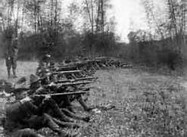
126: Filipino rebellion, 1899-1901 (Salvador)
The philippines rebel agaisnt the Spanish with the help of the U.S. This was a key event for the U.S since it helped the nation become an imperialist country.

Slide 3
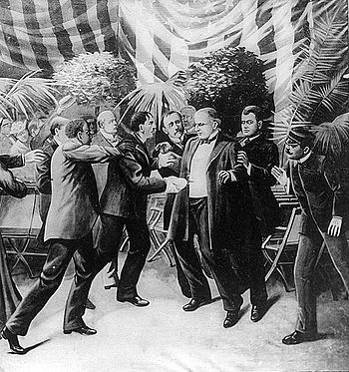
127: William Mckinley assassinated, 1901 (Salvador)
Mckinley was shot in The Temple of Music by Leon Czolgosz an anarchist who felt that Mckinley was a symbol of oppression

Slide 4
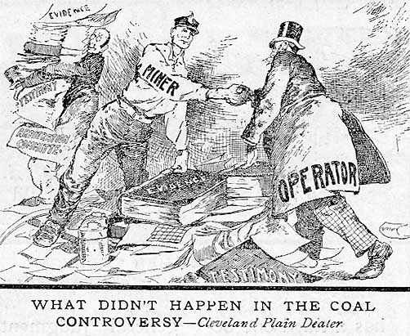
128: Theodore Roosevelt mediated coal miner's strike,1902
Roosevelt found a way for the miners to receive more pay for fewer hours and the owners got a high price for coal. The strike never resume because of his actions.

Slide 5
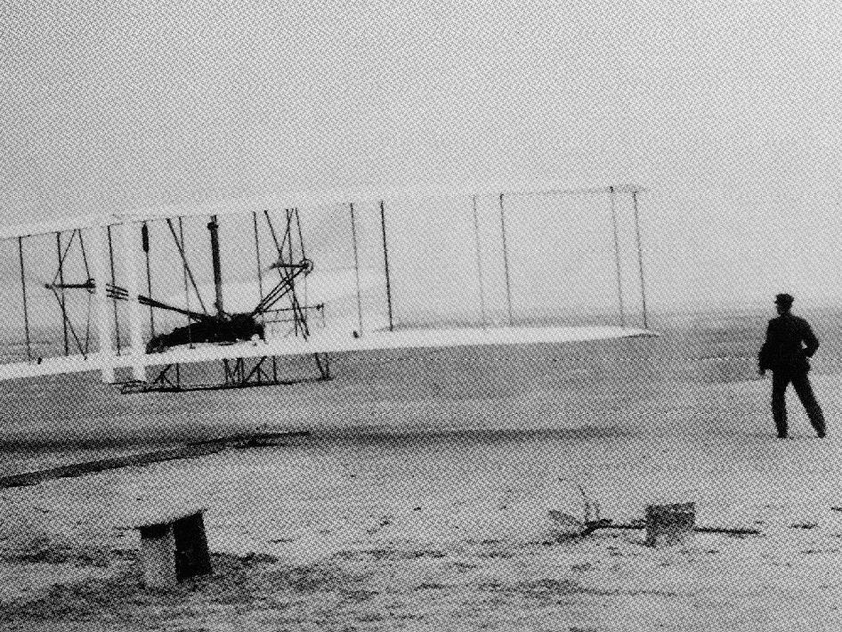
129: Wright Brothers flew first airplane, 1903 (Salvador)
In 1903 the wright brothers built the Wright Flyer I, it was first used on december 17 of that year. This was a big landmark since it prove that flying for man kind was passible. This later lead to a modern way of transportation.

Slide 6
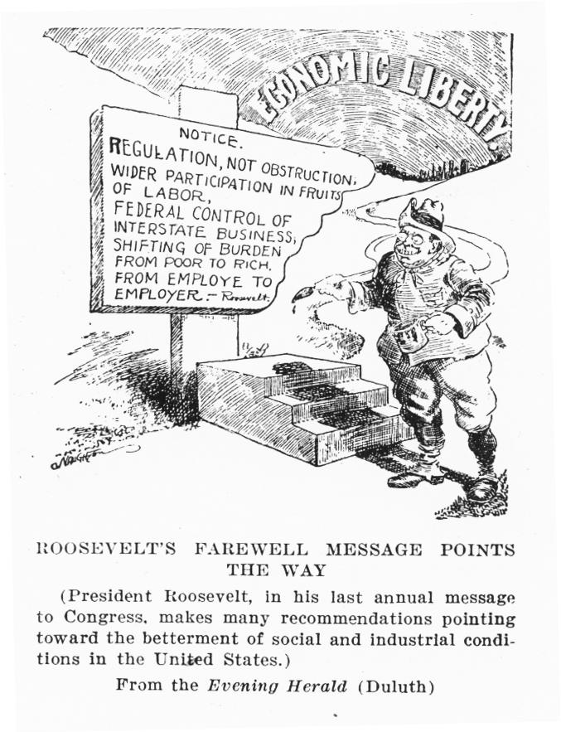
130: Northern Securities company broken up, 1904 (salvador)
It was one of the first anti-trust suits filled by Teddy Roosevelt. This was the first time the Sherman Anti-Trust act was used against a company and not a labor union.

Slide 7
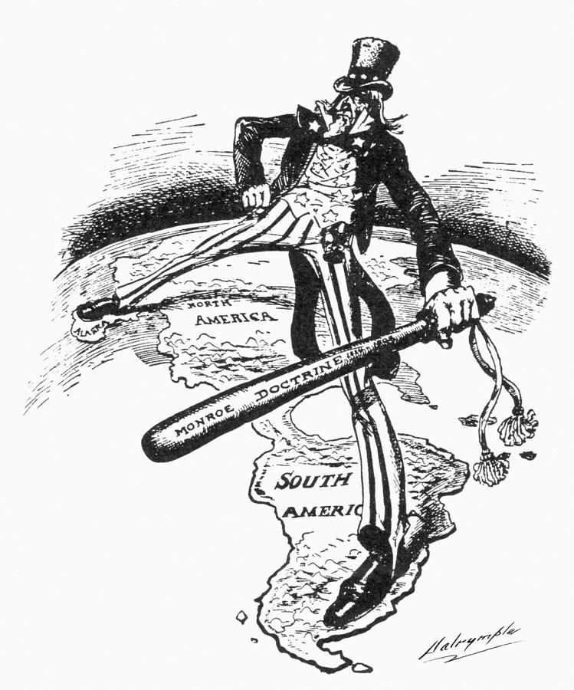
131:Roosevelt corollary,1904(Omar pontifes)
the roosevelt corollary was a propostion that the U.S. should protect the bussines intrest they had with Latin America as a measure to keep Europe out of Latin America. Roosevelt wanted to be the dominate power in the western hemisphere which led to bad relations with Latin America.

Slide 8
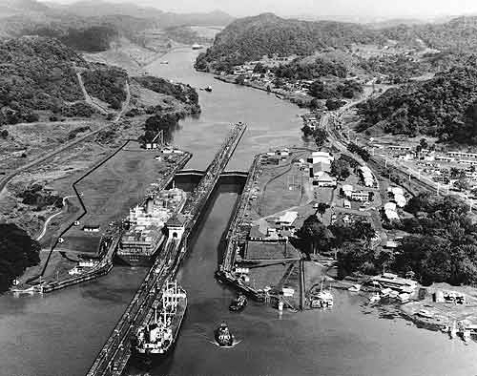
132:Hay-bunau-varilla Treaty, 1904 (Omar pontifes)
this treaty granted the U.S. long term control over the Panama Canal zone and was named after its negotiators.

Slide 9
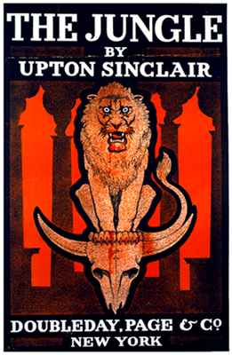
133:upton sinclair published the jungle (Omar pontifes)
The Jungle was a very inflential muckracking book that described the terrifying details that took place in Chicago. The book exposed the corruption and unsanitary practices of the stockyard and the meatpacking industry.

Slide 10
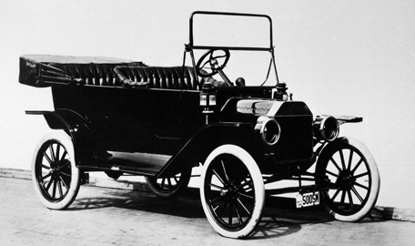
134: model t introduced, 1908 (omar pontifes)
The model T was the first mass produced car that was affordable for the average worker. The car was produced by Henry Ford's Motor Comapny October 1, 1908 to May 27, 1927.

Slide 11
135.NAACP Organized,1909
Jennifer Gonzalez
the NAACP was a civil rights organization that worked to end segragation and improve economic advancement
it was founded on feburary 12 1909
by 1913 the organization had branched offices in cities like boston, maryland,baltimore, etc...

Slide 12
136: Election of 1912
Jennifer Gonzalez
the election of 1912 was a 4-way contest between william howard taft,woodrow wilson, theodore roosevelt and eugene debs in the end woodrow wilson won the election with 435 electoral votes

Slide 13
137: 16th amendment, 1913
Jennifer Gonzalez
the 16th amendment allowed congress to levy a tax on incomes
the amendment was ratified on febrauary 3, 1913
the last three states to approve the amendment was delaware, wyoming, and new mexico

Slide 14
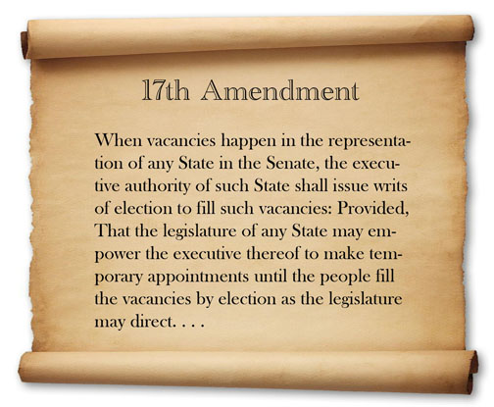
138:17th amendment,1913
Jennifer Gonzalez
The 17th amendment was ratified in 1913 it allowed for two senators from each sate to be elected for a term of 6 years

Slide 15
139:Federal reserve system created, 1913
Jennifer Gonzalez
the federal reserve system was a central banking system of the united states. it was founded in 1913 with the reenactment of the federal reserve act.

Slide 16
140: Clayton anti-trust act, 1914
Jennifer Gonzalez
the clayton anti-trust act strenghened the sherman anti-trust to break up monopolies

Slide 17
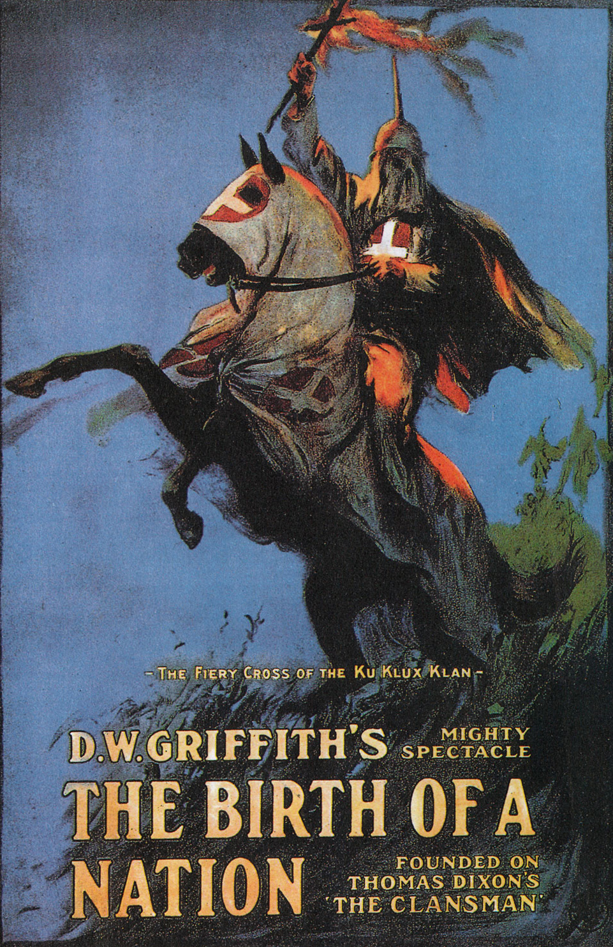
141: Birth of a nation, 1915 (marco Madrigal)
Originally called The Clansman
Is a American silent drama film, 1915
It was based on the play The Clansman

Slide 18
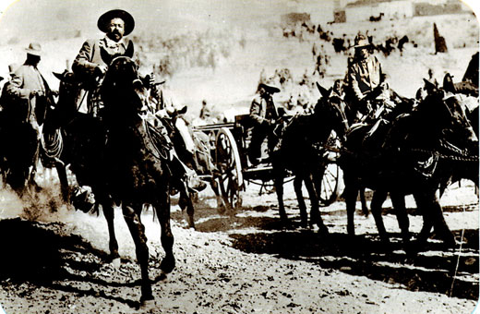
142: Pancho Villa's raid, 1916 (marco madrigal)
Villa and his troops attack a small town of Columbus, New Mexico
17 Americans were killed and the ceter of the town was burned
President Woodrow sended American military to Mexico to capture Villa but he was never found.

Slide 19
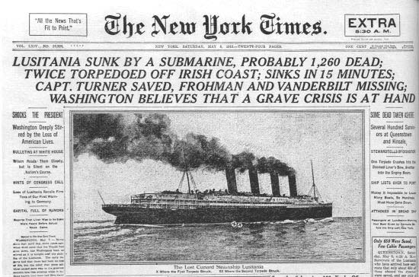
143: united states entered wwi, 1917 (Marco madrigal)
U.S. Senate votes 82 to 6 to declare war against Germany and the U.S. of Representatives votes 373 to 50

Slide 20
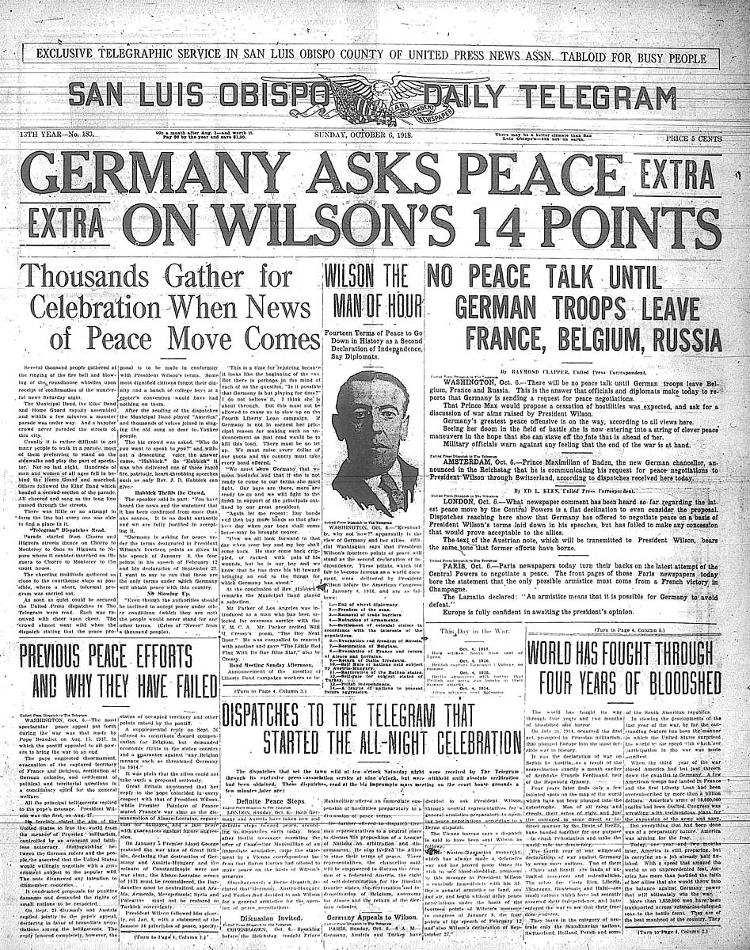
144: the fourteen points, 1918 (marco madrigal)
President Woodrow declared WWI was being fought for postwar peace in Europe
It was just basically 14 reasons why the U.S. went to war.

Slide 21
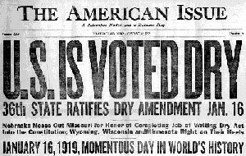
145: 18th amendment, 1919 (marco madrigal)
The 18th amendment prohibited the manufacture, sale, transport, import, or export of alcohal beverages

